Slide 1
Dayananda Sagar University
School of Engineering
Devarakaggalahalli, Harohalli Kanakapura Road, Dt, Ramanagara, Karnataka 562112
Department of Computer Science & Engineering
(Artificial Intelligence & Machine Learning)
FULL STACK DEVELOPMENT
SEMESTER – IV
Unit-1

Slide 2
Syllabus
UNIT – I
Introduction to HTML: HTML syntax HTML elements HTML document structure CSS selectors properties, and values Build your first web page Semantics of HTML Block and inline elements Hyperlinks, Lists, Tables, Forms Create a basic multi page website Cascading effect Advanced selectors CSS resets Positioning.

Slide 3
WHAT IS HTML
HTML - HyperText Markup Language
It is the standard language used to create and design webpages.
It provides the structure of a webpage by using elements like headings, paragraphs, images, links, and tables .
HTML works alongside CSS (Cascading Style Sheets) for styling and JavaScript for interactivity.

Slide 4
HTML syntax
<!DOCTYPE html>
<html>
<head>
<title>My First Webpage</title>
</head>
<body>
<h1>Welcome to My Website</h1>
<p>This is a simple webpage using HTML.</p>
<a href="https://www.example.com">Click here</a> to visit an example site.
</body>
</html>
Where,
<html>: The root element of an HTML document.
<head>: Contains metadata like the title and links to stylesheets.
<title>: Defines the title of the webpage (shown on the browser tab).
<body>: Contains the content of the webpage (text, images, links, etc.)
.<h1> to <h6>: Headings, where <h1> is the largest and <h6> is the smallest.
<p>: Paragraphs for text content.
<a>: Anchor tag for hyperlinks.
<img>: Displays images
.<table>, <div>, <span>, <form>, etc.:Used for layout and forms.

Slide 5
HTML elements
An HTML element is defined by a start tag, some content, and an end tag.
Syntax: <tagname>Content goes here...</tagname>
Examples of some HTML elements:
<h1>My First Heading</h1>
<p>My first paragraph.</p>
HTML elements can be nested (this means that elements can contain other elements).
Empty HTML Elements (no content)
Example <p>This is a <br> paragraph with a line break.</p>

Slide 6
HTML document structure
An HTML document follows a standard structure that defines the layout and elements of a webpage.
<!DOCTYPE html>
<html lang="en">
<head>
<meta charset="UTF-8">
<meta name="viewport" content="width=device-width, initial-scale=1.0">
<title>Simple Webpage</title>
</head>
<body>
<h1>Welcome to My Website</h1>
<p>This is a simple webpage created using HTML.</p>
<a href="https://www.example.com">Visit Example</a>
<h2>My Favorite Fruits</h2>
<ul>
<li>Apple</li>
<li>Banana</li>
<li>Orange</li>
</ul>
<p>&copy; 2025 My Website</p>
</body>
</html>

Slide 7
CSS selectors and advanced
A CSS selector selects the HTML element(s) we want to style.
CSS selectors are used to "find" (or select) the HTML elements we want to style. We can divide CSS selectors into five categories:
Simple selectors (select elements based on name, id, class)
Combinator selectors (select elements based on a specific relationship between them)
Pseudo-class selectors (select elements based on a certain state)
Pseudo-elements selectors (select and style a part of an element)
Attribute selectors (select elements based on an attribute or attribute value)

Slide 8
CSS selectors continued
The CSS element Selector-The element selector selects HTML elements based on the element name.
Example: Here, all <p> elements on the page will be center-aligned, with a red text color:
p { text-align: center; color: red; }
The CSS id Selector-The id selector uses the id attribute of an HTML element to select a specific element.
Example:The CSS rule below will be applied to the HTML element with id="para1":
#para1 { text-align: center; color: red; }

Slide 9
CSS selectors continued
The CSS Class Selector-The class selector selects HTML elements with a specific class attribute.
Example: In this example all HTML elements with class="center" will be red and center-aligned:
.center { text-align: center; color: red; }
The CSS Universal Selector-The universal selector (*) selects all HTML elements on the page.
* { text-align: center; color: blue; }

Slide 10
CSS selectors continued
The CSS Grouping Selector-The grouping selector selects all the HTML elements with the same style definitions.
h1 { text-align: center; color: red; } h2 { text-align: center; color: red; } p { text-align: center; color: red; }

Slide 11
HTML Properties and Values
In HTML, properties (often called attributes) provide additional information about elements. They are written inside the opening tag of an element and have corresponding values.
Attribute (Property) | Description | Example
id | Unique identifier for an element | <div id="header">
class | Assigns one or more classes for styling | <p class="intro">
style | Inline CSS styles | <h1 style="color: blue;">
title | Tooltip text on hover | <abbr title="HyperText Markup Language">HTML</abbr>
href | URL link for <a> elements | <a href="https://example.com">Visit</a>
src | Image or media source | <img src="image.jpg">
alt | Alternative text for images | <img src="logo.png" alt="Website Logo">
width & height | Image or iframe size | <img src="photo.jpg" width="300" height="200">

Slide 12
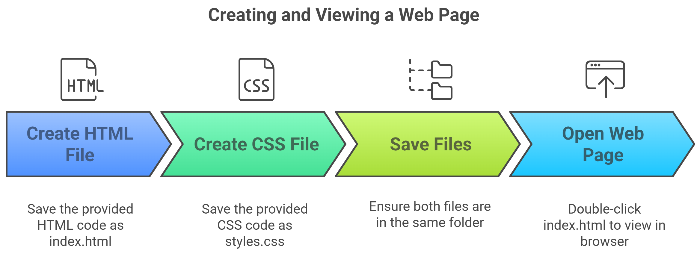
Build your first web page

Slide 13
Build your first web page
Create the HTML File:Save the following code as index.html
<!DOCTYPE html>
<html lang="en">
<head>
<meta charset="UTF-8">
<meta name="viewport" content="width=device-width, initial-scale=1.0"> <title>My First Web Page</title>
<link rel="stylesheet" href="styles.css">
</head>
<body>
<header>
<h1>Welcome to My Website</h1>
</header>

Slide 14
Build your first web page continued
<nav>
<ul>
<li><a href="#">Home</a>
</li> <li><a href="#">About</a></li>
<li><a href="#">Contact</a></li>
</ul>
</nav>
<section>
<h2>About Me
</h2> <p>This is my first web page, and I am excited to learn HTML!</p>
</section>
<footer>
<p>&copy; 2025 My Website. All rights reserved.</p>
</footer>
</body>
</html>

Slide 15
Build your first web page continued
Create the CSS File:Save the following as styles.css in the same folder
body {
font-family: Arial, sans-serif;
margin: 0;
padding: 0;
text-align: center;
background-color: #f4f4f4;
}
header {
background: #333;
color: white;
padding: 20px;}
nav ul {
list-style: none;
padding: 0;
}

Slide 16
Build your first web page continued
nav ul li {
display: inline;
margin: 10px;
}
nav ul li a {
text-decoration: none;
color: #333;
font-weight: bold;
}
section {
margin: 20px;
padding: 20px;
background: white;
border-radius: 5px;
box-shadow: 0 0 10px rgba(0, 0, 0, 0.1);
}
footer {
background: #333;
color: white;
padding: 10px;
position: absolute;
width: 100%;
bottom: 0;
}
Open Your Web Page
Double-click index.html to open it in a web browser

Slide 17
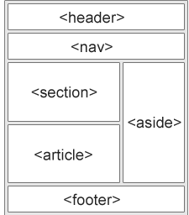
Semantics of HTML
A semantic element clearly describes its meaning to both the browser and the developer.
Examples of non-semantic elements: <div> and <span> - Tells nothing about its content.
Examples of semantic elements: <form>, <table>, and <article> - Clearly defines its content
Semantic Elements in HTML
Many web sites contain HTML code like:
<div id="nav"> <div class="header">
<div id="footer"> to indicate navigation,
header, and footer.

Slide 18
Semantics of HTML continued
The <section> element defines a section in a document. Examples- Chapters, Introduction, News items, Contact information
The <article> element specifies independent, self-contained content. Examples- Forum posts, Blog posts, User comments, Product cards, Newspaper articles
The <header> element represents a container for introductory content or a set of navigational links. Examples-one or more heading elements (<h1> - <h6>),logo or icon,authorship information
The <footer> element defines a footer for a document or section. Examples-authorship information, copyright information, contact information, sitemap
The <nav> element defines a set of navigation links.
The <aside> element defines some content aside from the content it is placed in (like a sidebar).

Slide 19
Block and inline elements
Every HTML element has a default display value, depending on what type of element it is. The two most common display values are block and inline.
Block-level Elements:
A block-level element always starts on a new line, and the browsers automatically add some space (a margin) before and after the element.
A block-level element always takes up the full width available (stretches out to the left and right as far as it can).
Two commonly used block elements are: <p> and <div>.
The <p> element defines a paragraph in an HTML document.
The <div> element defines a division or a section in an HTML document.
Example:<p>Hello World</p> <div>Hello World</div>

Slide 20
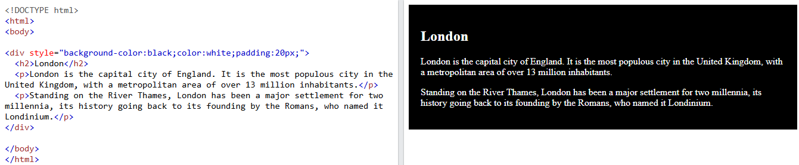
Block and inline elements
Inline Elements
An inline element does not start on a new line.
An inline element only takes up as much width as necessary.
This is a <span> element inside a paragraph.
Example: <span>Hello World</span>

Slide 21
Hyperlinks
Hyperlinks (<a> tag) are used to link pages, external websites, sections within a
page, emails, and more.
Basic Hyperlink Syntax
<a href="https://www.google.com">Visit Google</a>
href → Specifies the URL. Clicking on "Visit Google" will open Google.
Link to Another Page in the Same Website syntax
<a href="about.html">About Us</a>
Links to about.html (another page in the same directory).

Slide 22
Hyperlinks
<!DOCTYPE html>
<html lang="en">
<head>
<meta charset="UTF-8">
<title>Hyperlink Examples</title>
</head>
<body>
<h1>Hyperlink Examples</h1> <p><a href="https://www.google.com" target="_blank">Open Google in a new tab</a></p>
</body>
</html>

Slide 23
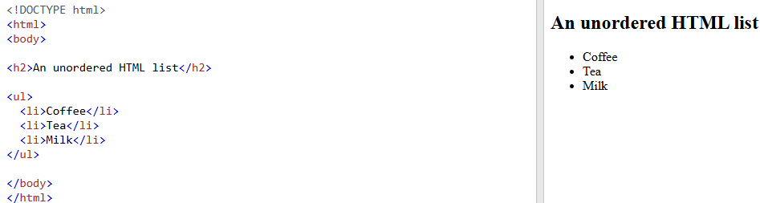
Lists
HTML lists allow web developers to group a set of related items in lists:Ordered and unordered lists.
Unordered HTML List-An unordered list starts with the <ul> tag. Each list item starts with the <li> tag.

Slide 24
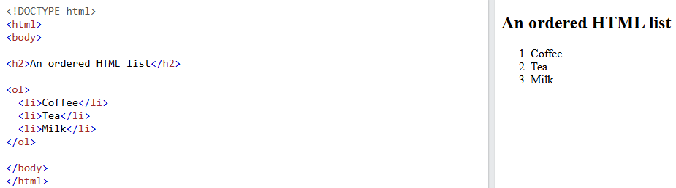
Lists continued
Ordered HTML List-An ordered list starts with the <ol> tag. Each list item starts with the <li> tag

Slide 25
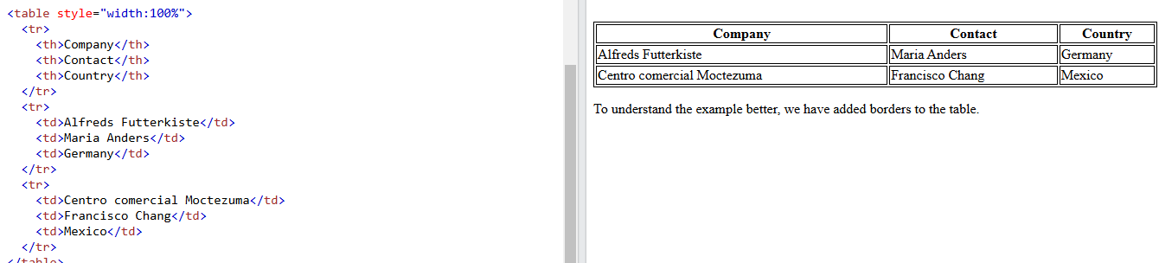
Tables
HTML tables allow web developers to arrange data into rows and columns-A ta
ble in HTML consists of table cells inside rows and columns.

Slide 26
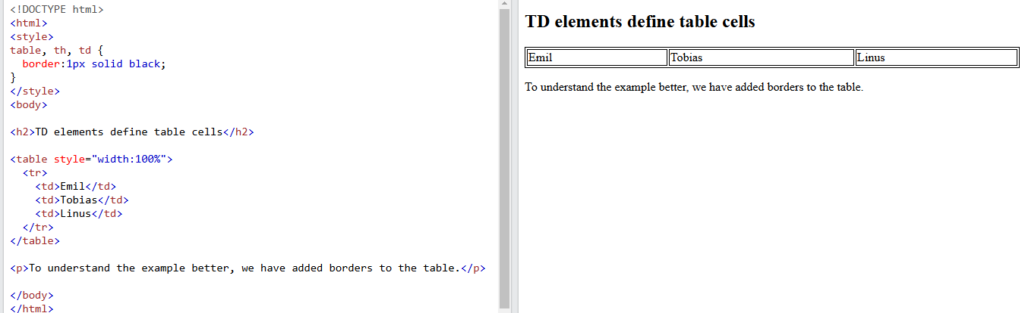
Tables continued
Table Cells-Each table cell is defined by a <td> and a </td> tag.
td stands for table data. Everything between <td> and </td> are the content of the table cell.

Slide 27
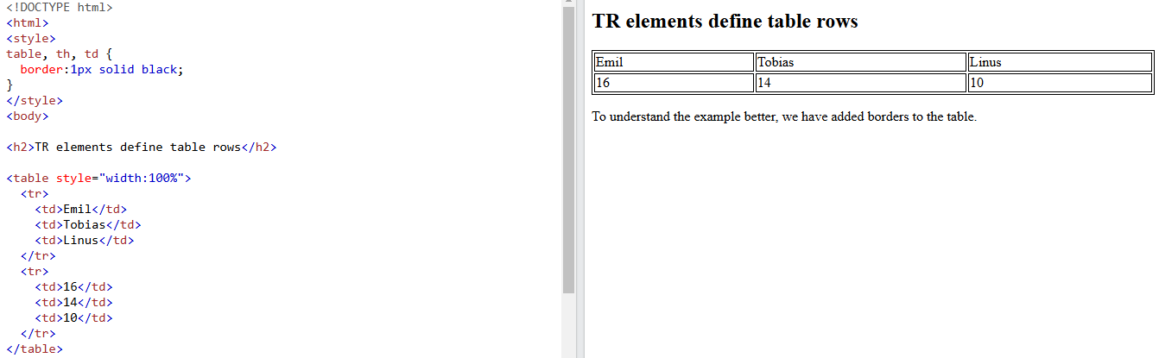
Tables continued
Table Rows-Each table row starts with a <tr> and ends with a </tr> tag. tr stands for table row.

Slide 28
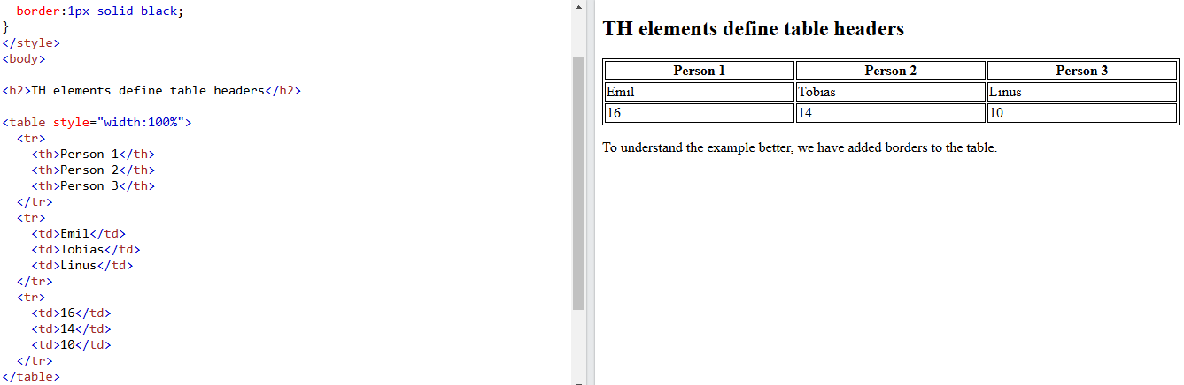
Tables continued
Table Headers- To make the cells to be table header cells. In those cases use the <th> tag instead of the <td> tag. th stands for table header.

Slide 29
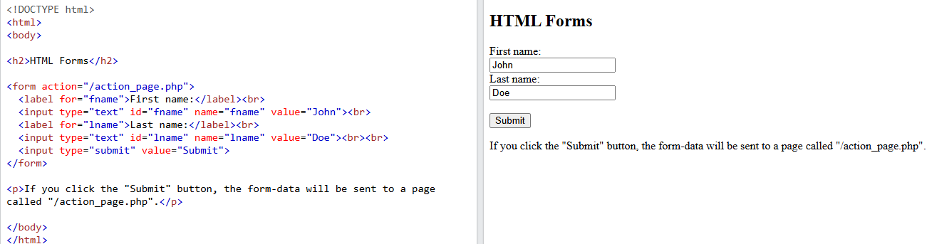
Forms
An HTML form is used to collect user input. The user input is most often sent to a server for processing.

Slide 30
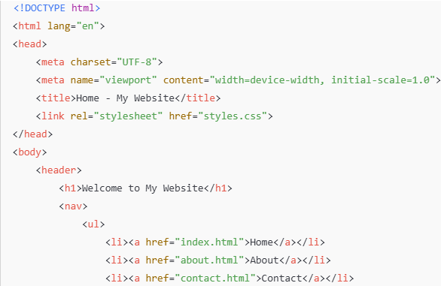
Creating a Basic Multi-Page Website
Example: ✅ Home Page ✅ About Page ✅ Contact Page ✅ Navigation Menu
Home Page (index.html)

Slide 31
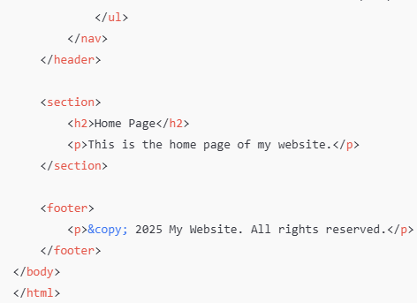
Creating a Basic Multi-Page Website

Slide 32
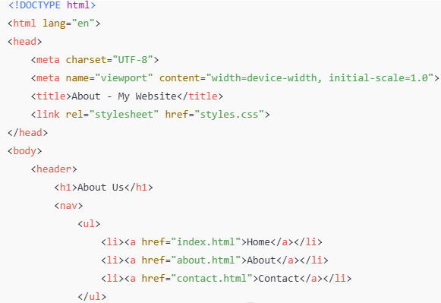
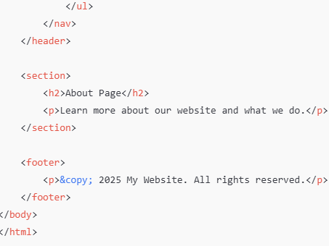
Creating a Basic Multi-Page Website
About Page (about.html)

Slide 33
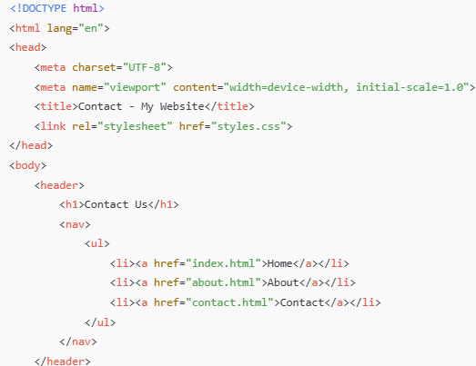
Creating a Basic Multi-Page Website
Contact Page (contact.html)

Slide 34
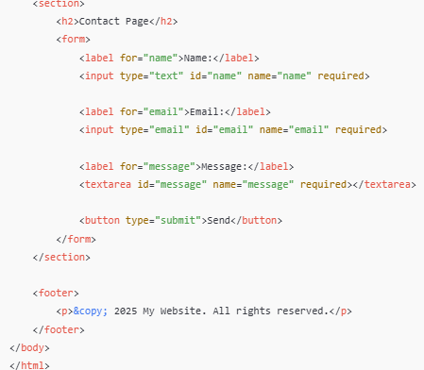
Creating a Basic Multi-Page Website

Slide 35
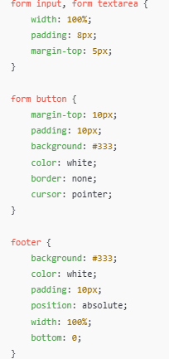
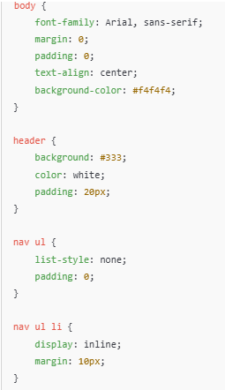
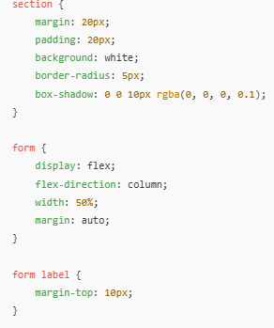
Creating a Basic Multi-Page Website
CSS File (styles.css)

Slide 36
Creating a Basic Multi-Page Website
Running the Website
Save all the files in a folder
Open index.html in a web browser.
Click the navigation links to switch between pages.

Slide 37
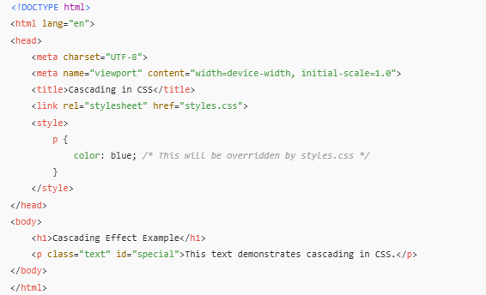
Cascading effect
Cascading in HTML -The term "Cascading" in Cascading Style Sheets (CSS) refers to how styles are applied to elements based on priority rules

Slide 38
CSS Resets
CSS resets are used to remove default browser styling (like margins, paddings, font sizes, and heading styles) to create a consistent baseline across different browsers. Each browser applies default styles differently, which can cause inconsistencies in the web design.
Basic CSS Reset: For a quick reset (small projects).
{
margin: 0;
padding: 0;
box-sizing:
border-box;
}
where, margin: 0; padding: 0; → removes default spacing.
box-sizing: border-box; → makes width calculations easier.

Slide 39
CSS Resets
Eric Meyer’s CSS Reset: Resets almost all elements, Removes list bullets, table spacing, and border styling, Normalizes font and vertical alignment.
/* Set default styles */
body {
line-height: 1;
}
ol, ul {
list-style: none;
}table {
border-collapse: collapse;
border-spacing: 0;
}
html, body, div, h1, h2, dl, dt{
margin: 0;
padding: 0;
border: 0;
font-size: 100%;
font: inherit;
vertical-align: baseline;
}

Slide 40
CSS Resets
A Custom Modern Reset: For a minimal but effective reset. Keeps a clean layout while maintaining readability. Useful for modern web designs.
{
margin: 0;
padding: 0;
box-sizing: border-box;
}
body
{ font-family:
Arial, sans-serif;
line-height: 1.6;
color: #333;
background-color: #f8f9fa;
}
A
{ text-decoration:
none; color: inherit;
}
ul, ol
{
list-style: none;
}

Slide 41
Positioning
CSS positioning controls how elements are placed on a webpage. There are five main position values:
Static (default)
Relative
Absolute
Fixed
Sticky
Static Position (Default)
Default behavior of all elements, No special positioning applied, can't use top, left, right, or bottom.
div {
position: static;
}

Slide 42
Positioning continued
Relative Position-An element is positioned relative to its original position. Can use top, left, right, bottom to move it, Other elements do not shift; only the positioned element moves.
.box {
position: relative;
left: 50px; /* Moves right by 50px */
top: 20px; /* Moves down by 20px */
}
Absolute Position-An element is positioned relative to the nearest positioned ancestor (relative, absolute, fixed) or the <html> if no ancestor is positioned. Removed from normal flow; it does not affect siblings. Can be placed anywhere inside a parent container.Parent must have position: relative; to control it.

Slide 43
Positioning continued
.parent {
position: relative; /* Needed to control absolute child */
width: 300px;
height: 200px;
background: lightblue;
}
.child {
position: absolute;
right: 20px;
bottom: 10px;
background: red;
}

Slide 44
Positioning continued
Fixed Position-The element is positioned relative to the viewport (the screen), staying fixed even when scrolling. Always stays in the same place.Useful for navigation bars, floating buttons, etc.
.fixed-nav {
position: fixed;
top: 0;
width: 100%;
background: black;
color: white;
padding: 10px;
}

Slide 45
Positioning continued
Sticky Position-An element acts like relative until scrolling reaches a certain point, then sticks like fixed. Great for sticky headers or sidebars. Only works if parent has enough height.
.sticky-header {
position: sticky;
top: 0;
background: yellow;
padding: 10px;
}

